Slide 1




Outline
1
Introduction Memory
Memory Hierarchy
Memory Management System
Main Memory Auxiliary Memory Associative Memory Cache Memory
Characteristic of Cache Memory Associative Mapping
Direct Mapping
Set- Associative Mapping
Virtual Memory
2
3
4
5
6
Unit 4 - Memory Organization

Slide 2
Memory
The memory that communicates directly with CPU is called main memory.
Devices that provides backup storage are called auxiliary memory.
Only program and data currently needed by the processor resides in main memory.
All other information is stored in auxiliary memory and transferred to main memory when needed.
Unit 4 - Memory Organization

Slide 3
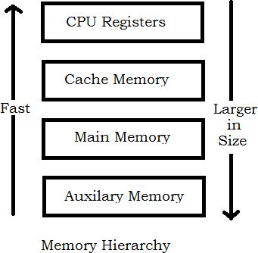
Memory Hierarchy
Unit 4 - Memory Organization

Slide 4
CPU Register - also known as Internal Processor Memory. The data or instruction which has to be executed are kept in these registers.
The Cache Memory is employed in computer system to compensate for the speed differential between main memory access time and processor logic.
The cache is used for storing segments of programs currently being executed in the CPU and temporary data frequently needed in the present calculations.
By making program and data available at a rapid rate, it is possible to increase the performance rate of the computer.
Unit 4 - Memory Organization

Slide 5
Memory Management System
Many operating system are designed to enable the CPU to process a number of independent programs concurrently - known as multiprogramming.
Sometimes a program are too long to be accommodated in total space available in main memory. A program with its data normally resides in auxiliary memory.
When the program or a segment of program is to be executed, it is transfered to main memory to be executed by the CPU.
The part of the computer system that supervise the flow of information between auxiliary memory and main memory is called the memory management system.
Unit 4 - Memory Organization

Slide 6
Main Memory
The principal technology used for main memory is based on
semiconductor integrated circuit.
The Integrated circuit chips are available in two possible operating modes:
^{e} Static
^{e} Dynamic
The Static RAM consists essentially of internal flip-flop that store the binary information.
The dynamic RAM stores the binary information in form of electronic charges that are applied to capacitors.
The stored charge on the capacitor tend to discharge with time and the capacitors must be periodically recharged by refreshing the dynamic memory.
The static RAM is easier to use and has shorter read and write cycles and used in cache.
The dynamic RAMs are used for implementing the main memory.
Unit 4 - Memory Organization

Slide 7
Auxiliary Memory
The Most common auxiliary memory devices used in computer system are magnetic disk and tapes.
Other components used, but not as frequently, are magnetic drums, magnetic bubble memory, and optical disks.
The average time required to reach a storage location in memory and obtain its contents is called the access time.
In electromechanical devices with moving parts such as disks an tapes, the access time consists of seek time required to position the read-write head to a location and a transfer time required to transfer data to or from the devices.
Unit 4 - Memory Organization

Slide 8
Associative Memory
An assembler program searches the symbol address table in order to extract the symbol’s binary equivalent.
The number of accesses to memory depends on the location of the item and the efficiency of search algorithm.
Many search algorithm have been developed to minimize the number of access while searching for an item in a random or sequential access memory.
The time required to find an item stored in memory can be reduced considerably if stored data can be identified by the content of the data itself rather than an address.
A memory unit accessed by content is called an associative memory or content addressable memory(CAM).
Unit 4 - Memory Organization

Slide 9
Associative Memory
This type of memory is accessed simultaneously and in parallel on the basis of data content rather then by specific address or location.
When a word is written in an associative memory, no address is given. The memory is capable of finding an empty unused location to store the word.
When a word is to be read from an associative memory, the content of the word, or part of the word, is specified. The memory locates all words which match the specified content and marks them for reading.
An associative memory is more expensive than a random access memory, so are used in application where the search time is very critical and must be very short.
Unit 4 - Memory Organization

Slide 10
Cache Memory
A typical computer program flows in a straight-line fashion with program loops and subroutine calls encountered frequently.
Analysis of a large number of typical programs has been shown that the reference to memory at any given interval of time tend to be confined within a few localized areas in memory. This phenomenon is known as the property of locality of reference.
If the active portions of the program and data are placed in a fast small memory, the average memory access time can be reduced, thus reducing the total execution time of program. Such memory is known as Cache memory.
Unit 4 - Memory Organization

Slide 11
Cache Memory
The Performance of cache memory is frequently measured in terms of a quantity called hit ratio.
When the CPU refers to memory and finds the word in cache, it is said to produce a hit.
If the word is not found in cache, it is in main memory and it counts as a miss.
Unit 4 - Memory Organization

Slide 12
Characteristic of Cache Memory
The basic characteristic of cache memory is its fast access time.
The transformation of data from main memory to cache memory is referred to as a mapping process.
Three types of mapping procedures are:
^{e} Associative Mapping
^{e} Direct Mapping
^{e} Set-associative Mapping
Unit 4 - Memory Organization

Slide 13
Associative Mapping
The fastest and most flexible cache organization uses an associative memory.
The associative memory stores both the address and content (data) of the memory word.
If the address is found corresponding data is read otherwise main memory is accessed for the word.
It is expensive compared to random-access memories because of the added logic associated with each cell.
Unit 4 - Memory Organization

Slide 14
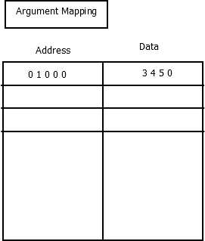
Associative Mapping
Unit 4 - Memory Organization

Slide 15
Direct Mapping
The n-bit memory address is divided into two Fields: k-bits for the index field and n-k bits for the tag field.
The direct mapping cache organization uses the n-bit address to access the main memory and the k-bit index to access the cache.
Each word in cache consists of the data word and its associated tag.
When a new word is first brought into the cache, the tag bits are stored alongside the data bits.
When the CPU generates a memory request, the index field is used for the address to access the cache.
The tag field of the CPU address is compared with the tag in the word read from cache.
If the two tags match, there is a hit and the required word is read from cache otherwise it is read from main memory.
Unit 4 - Memory Organization

Slide 16
Set- Associative Mapping
In Direct mapping, every time a miss occurs, an entire block of words must be transfered from main memory to cache memory.
Another disadvantage of direct mapping is that two words with the same index in their address but with different tag values cannot reside in cache memory at same time.
A third type of cache organization, called set-associative mapping, in which each word of cache can store two or more words of memory under the same index address.
Each data word is stored together with its tag and the number of tag-data items in one word of cache is said to from a set.
Unit 4 - Memory Organization

Slide 17
Virtual Memory
In a memory hierarchy system, program and data are first stored in auxiliary memory.
Portion of a program or data are brought into main memory as they are needed by the CPU.
Virtual Memory is a concept used in some large computer systems that permit the user to construct programs as though a large memory space were available, equal to the totality of auxiliary memory.
A virtual memory system provides a mechanism for translating program-generated addresses into correct main memory locations.
An address used by a programmer will be called a virtual address, and set of such addresses the address space.
An address in main memory is called a location or physical address and the set of such addresses is called memory space.
Unit 4 - Memory Organization

Slide 18
THANK YOU
Unit 4 - Memory Organization

Slide 19
Pipelining and Vector
Processing
Parallel Processing, Flynn’s Classification of
Computers
Pipelining
Instruction Pipeline
Pipeline Hazards and their solution
Array and Vector Processing

Slide 20
Parallel Processing
It refers to techniques that are used to provide
simultaneous data processing.
The system may have two or more ALUs to be able to execute two or more instruction at the same time.
The system may have two or more processors
operating concurrently.
It can be achieved by having multiple functional units that perform same or different operation simultaneously.

Slide 21
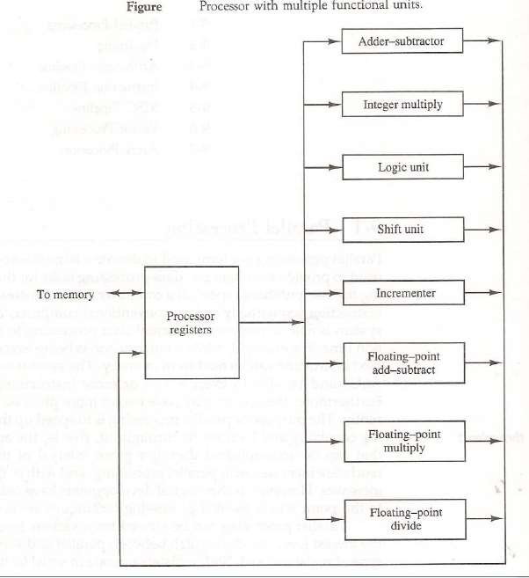

Slide 22
Classification
There are variety of ways in which the parallel
processing can be classified
  Internal Organization of Processor
  Interconnection structure between processors
  Flow of information through system

Slide 23
M.J. Flynn classify the computer on the basis of number of instruction and data items processed simultaneously.
  Single Instruction Stream, Single Data Stream(SISD)
  Single Instruction Stream, Multiple Data Stream(SIMD)
  Multiple Instruction Stream, Single Data Stream(MISD)
  Multiple Instruction Stream, Multiple Data Stream(MIMD)

Slide 24
SISD represents the organization containing single control unit, a processor unit and a memory unit. Instruction are executed sequentially and system may or may not have internal parallel processing capabilities.
SIMD represents an organization that includes many processing units under the supervision of a common control unit.

Slide 25
MISD structure is of only theoretical interest since no practical system has been constructed using this organization.
MIMD organization refers to a computer system capable of processing several programs at the same time.

Slide 26
Flynn’s classification emphasize on the behavioral characteristics of the computer system rather than its operational and structural interconnections. One type of parallel processing that does not fit in the Flynn’s classification is Pipelining.
Parallel Processing can be discussed under following topics:
  Pipeline Processing
  Vector Processing
  Array Processors

Slide 27
Pipelining
It is a technique of decomposing a sequential process into sub operations, with each sub process being executed in a special dedicated segments that operates concurrently with all other segments.
Each segment performs partial processing dictated
by the way task is partitioned.
The result obtained from each segment is transferred to next segment.
The final result is obtained when data have passed through all segments.

Slide 28
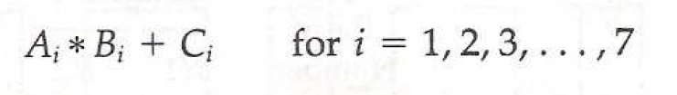
Example
Suppose we have to perform the following task:
Each sub operation is to be performed in a segment within a pipeline. Each segment has one or two registers and a combinational circuit.

Slide 29
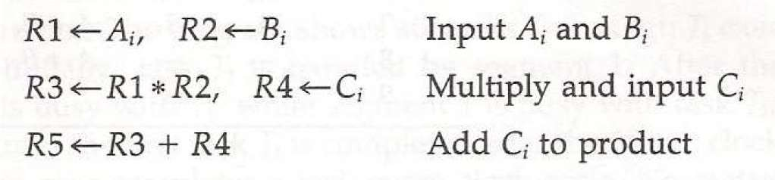
The sub operations in each segment of the pipeline
are as follows:

Slide 30
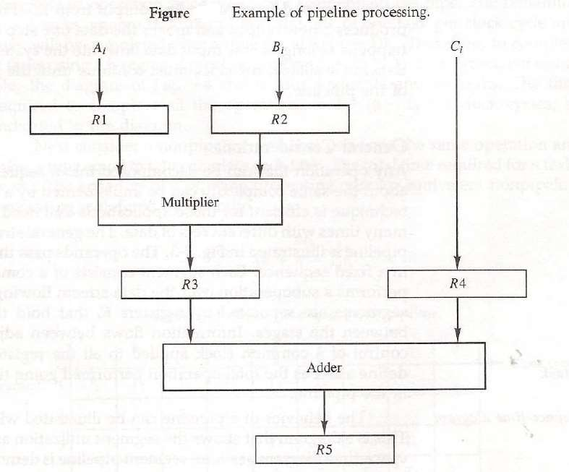

Slide 31
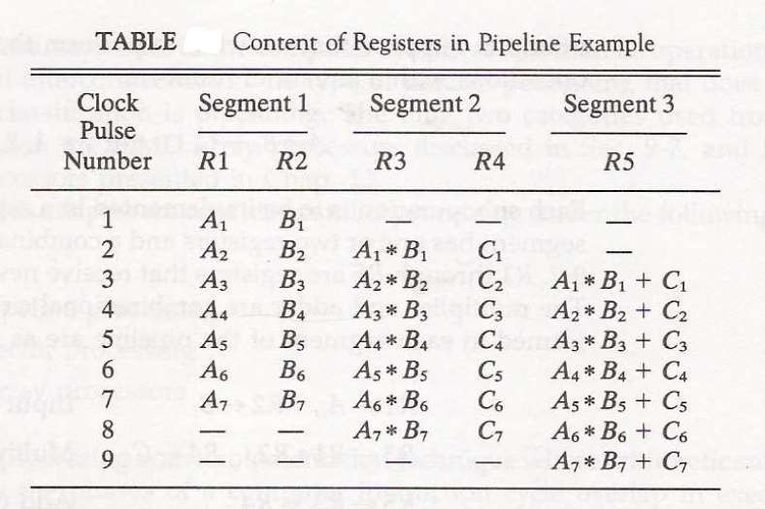

Slide 32
General Consideration
Let us consider the case where k segments pipeline
with a clock cycle time tp is used to execute n tasks.
The first task T1 require time ktp to complete since there are k segments.
The remaining (n-1) tasks emerge from pipe at the rate one task per cycle. They will complete after time (n-1)tp.
So total time required is k+(n-1) clock cycles.
Calculate total cycles in previous example.

Slide 33
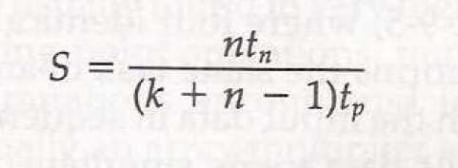
Now consider non pipeline unit that performs the same operation and takes time equal to tn to complete each task.
Total time required is ntn.
The speedup ration is given as:

Slide 34
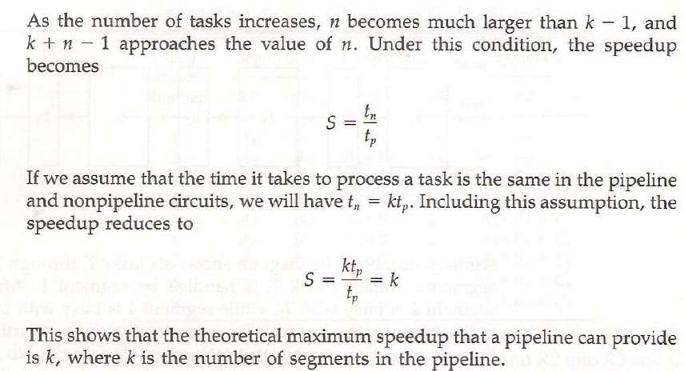

Slide 35
Arithmetic Pipeline
Pipeline arithmetic units are usually found in very
high speed computers.
They are used to implement floating point operations.
We will now discuss the pipeline unit for the floating
point addition and subtraction.

Slide 36
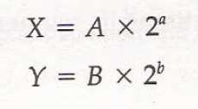
The inputs to floating point adder pipeline are two
normalized floating point numbers.
A and B are mantissas and a and b are the exponents.
The floating point addition and subtraction can be
performed in four segments.

Slide 37
The sub-operation performed in each segments are:
  Compare the exponents
  Align the mantissas
  Add or subtract the mantissas
  Normalize the result

Slide 38
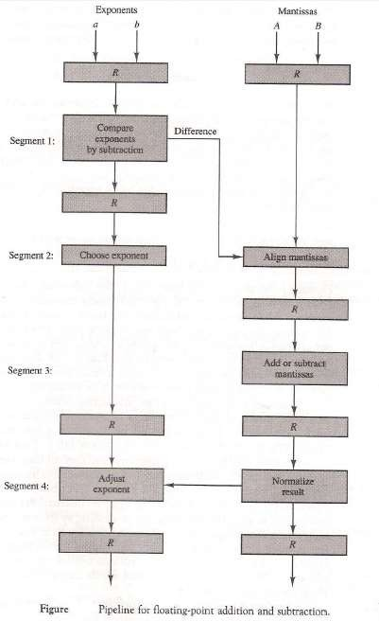

Slide 39
Instruction Pipeline
Pipeline processing can occur not only in the data
stream but in the instruction stream as well.
An instruction pipeline reads consecutive instruction from memory while previous instruction are being executed in other segments.
This caused the instruction fetch and execute segments to overlap and perform simultaneous operation.

Slide 40
Four Segment CPU Pipeline
FI segment fetches the instruction.
DA segment decodes the instruction and calculate the effective address.
FO segment fetches the operand.
EX segment executes the instruction.

Slide 41
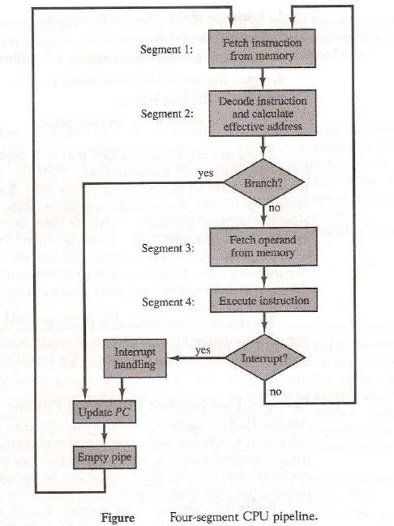

Slide 42
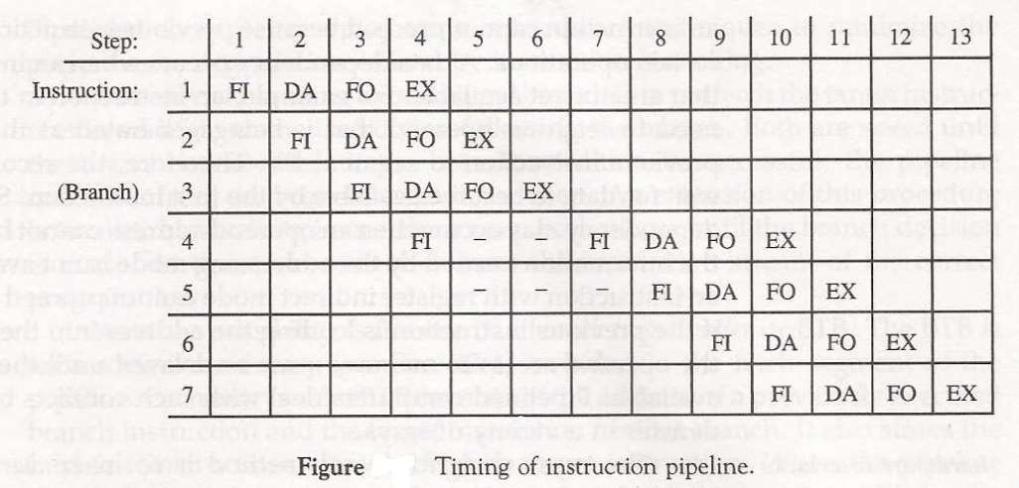

Slide 43
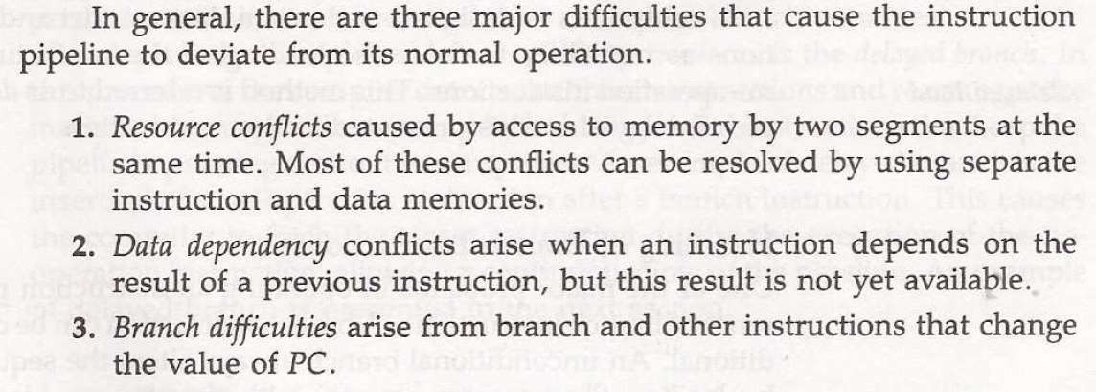

Slide 44
Handling Data Dependency
This problem can be solved in the following ways:
  Hardware interlocks: It is the circuit that detects the conflict situation and delayed the instruction by sufficient cycles to resolve the conflict.
  Operand Forwarding: It uses the special hardware to detect the conflict and avoid it by routing the data through the special path between pipeline segments.
  Delayed Loads: The compiler detects the data conflict and reorder the instruction as necessary to delay the loading of the conflicting data by inserting no operation instruction.

Slide 45
Handling of Branch Instruction
Pre fetch the target instruction.
Branch target buffer(BTB) included in the fetch segment of the pipeline
Branch Prediction
Delayed Branch

Slide 46
RISC Pipeline
Simplicity of instruction set is utilized to implement an instruction pipeline using small number of sub- operation, with each being executed in single clock cycle.
Since all operation are performed in the register,
there is no need of effective address calculation.

Slide 47
Three Segment Instruction Pipeline
I: Instruction Fetch
A: ALU Operation
E: Execute Instruction

Slide 48
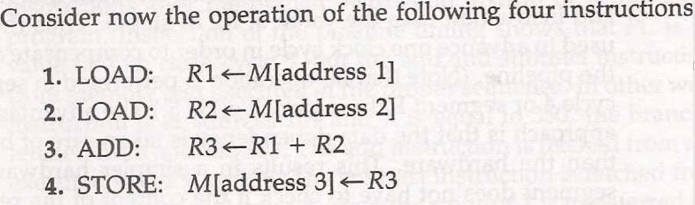
Delayed Load

Slide 49
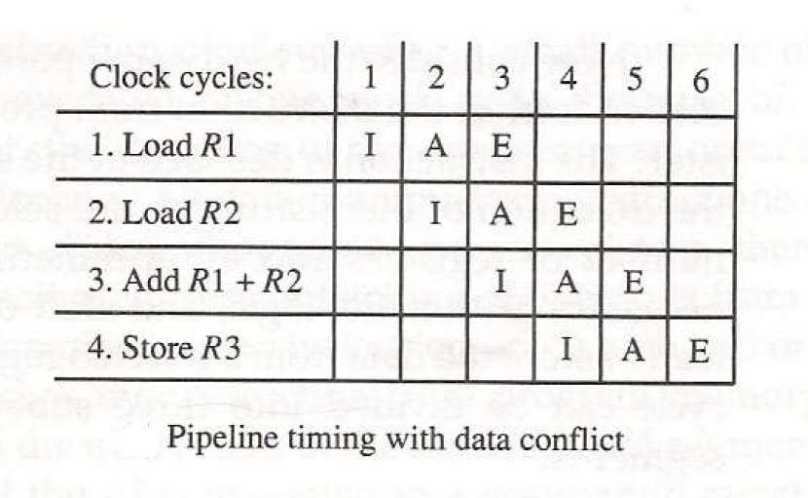

Slide 50
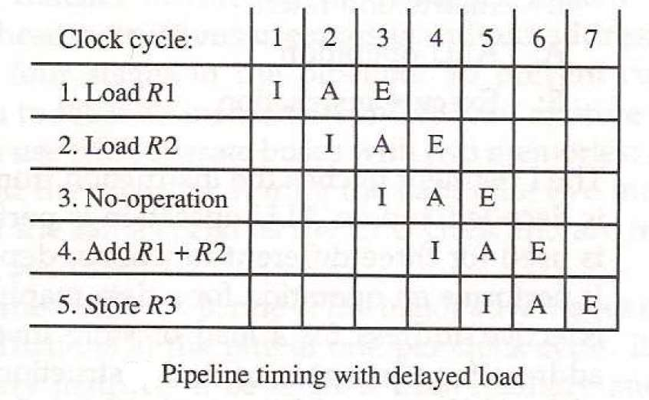

Slide 51
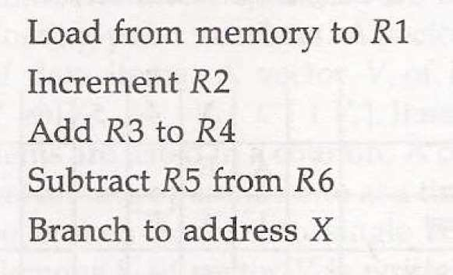
Delayed Branch
Let us consider the program having the following 5
instructions

Slide 52
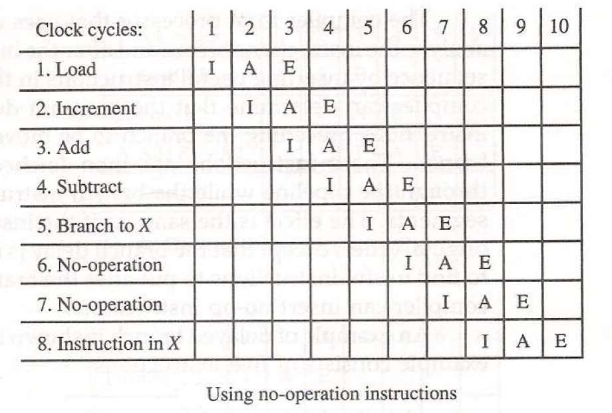

Slide 53
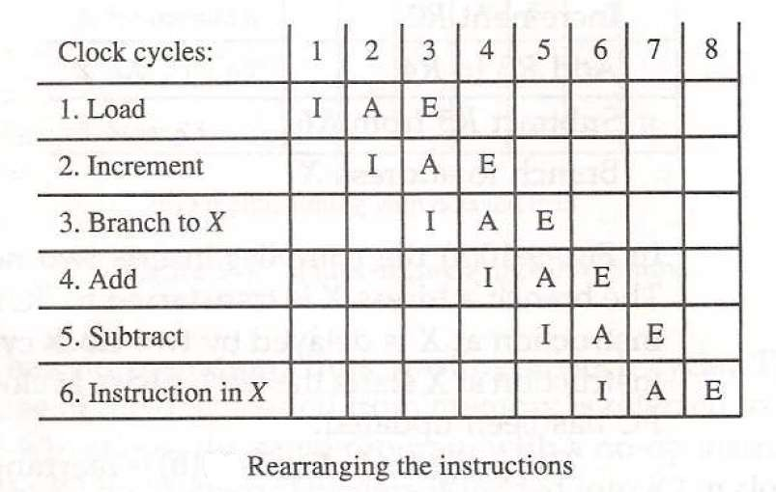

Slide 54
Vector Processing
There is a class of computational problems that are beyond the capabilities of the conventional computer.
These are characterized by the fact that they require vast number of computation and it take a conventional computer days or even weeks to complete.
Computers with vector processing are able to handle such instruction and they have application in following fields:

Slide 55
Long range weather forecasting
Petroleum exploration
Seismic data analysis
Medical diagnosis
Aerodynamics and space simulation
Artificial Intelligence and expert system
Mapping the human genome
Image Processing

Slide 56

Vector Operation
A vector V of length n is represented as row vector by
The element Vi of vector V is written as V(I) and the index I refers to a memory address or register where the number is stored.

Slide 57
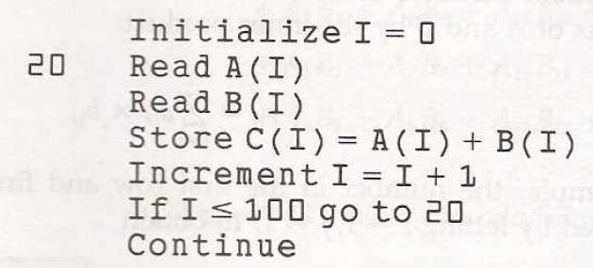
Let us consider the program in assembly language that two vectors A and B of length 100 and put the result in vector C.

Slide 58

A computer capable of vector processing eliminates the overhead associated with the time it takes to fetch and execute the instructions in the program loop.
It allows operations to be specified with a single
vector instruction of the form:

Slide 59
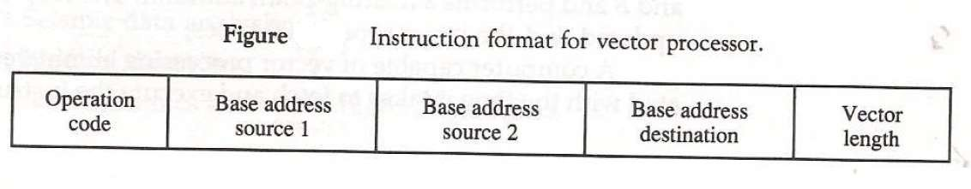

Slide 60
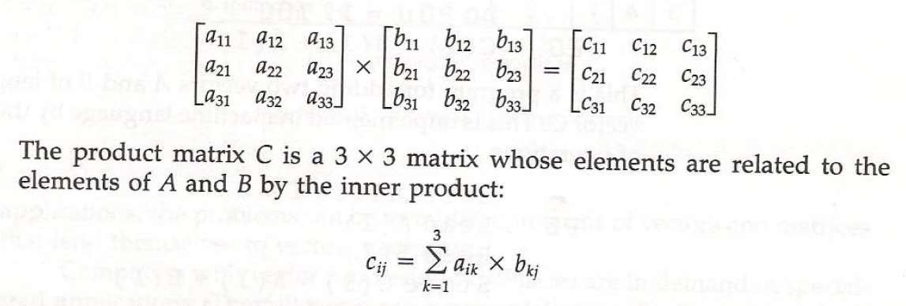
Matrix Multiplication
Let us consider the multiplication of two 3*3 matrix
A and B.

Slide 61
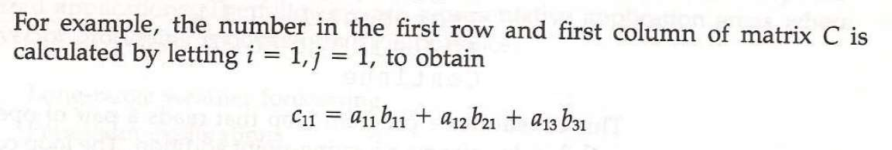
This requires three multiplication and(after
initializing c11 to 0) three addition.
Total number of addition or multiplication required is 3*9.
In general inner product consists of the sum of k
product terms of the form:

Slide 62
In typical application value of k may be 100 or even 1000.
The inner product calculation on a pipeline vector
processor is shown below.
Floating point adder and multiplier are assumed to
have four segments each.

Slide 63
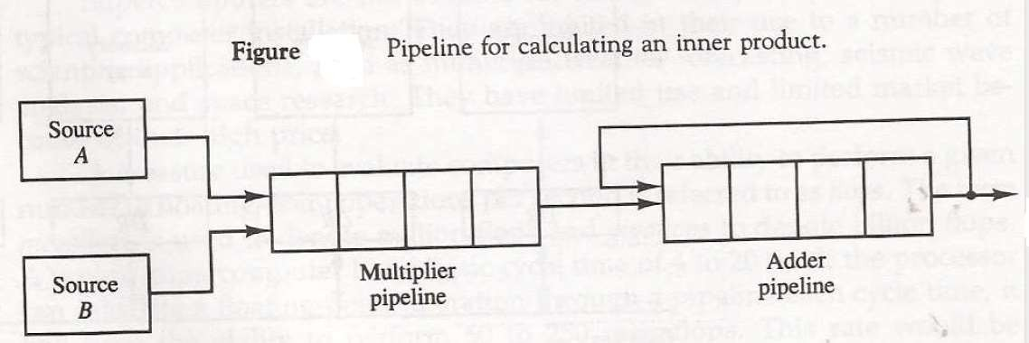

Slide 64
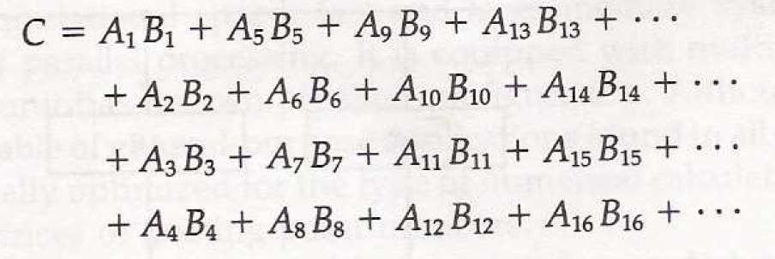
The four partial sum are added to form the final sum

Slide 65
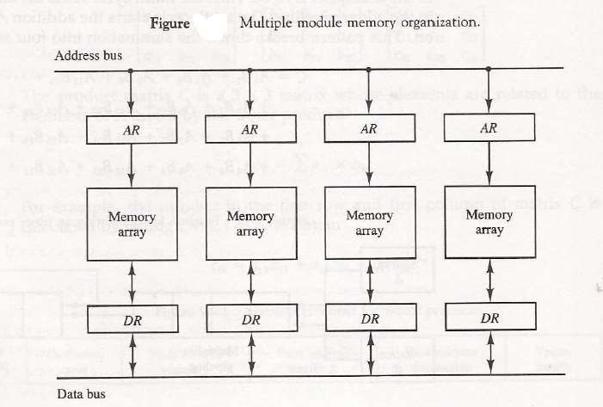
Memory Interleaving

Slide 66
Array Processor
An array processor is a processor that performs the
computations on large arrays of data.
There are two different types of array processor:
  Attached Array Processor
  SIMD Array Processor

Slide 67
Attached Array Processor
It is designed as a peripheral for a conventional host
computer.
Its purpose is to enhance the performance of the computer by providing vector processing.
It achieves high performance by means of parallel
processing with multiple functional units.

Slide 68
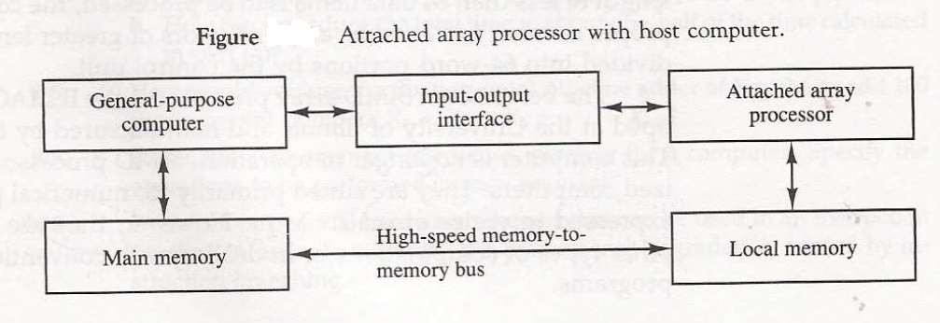

Slide 69
SIMD Array Processor
It is processor which consists of multiple processing
unit operating in parallel.
The processing units are synchronized to perform the same task under control of common control unit.
Each processor elements(PE) includes an ALU , a
floating point arithmetic unit and working register.

Slide 70
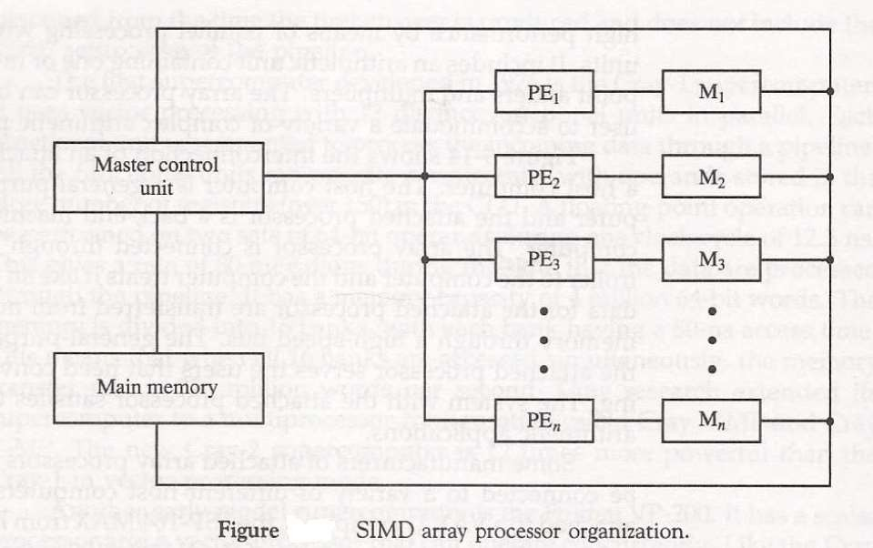

Slide 71
Multiprocessors
1
MULTIPROCESSORS
Characteristics of Multiprocessors
Interconnection Structures
Interprocessor Arbitration
Interprocessor Communication and Synchronization
Cache Coherence

Slide 72
Multiprocessors
2 Characteristics of Multiprocessors
Characteristics of Multiprocessor systems
A multiprocessor system is an interconnection of two or more CPU’s with memory and input-output equipment.
Multiprocessors system are classified as multiple instruction stream, multiple
data stream systems(MIMD).
There exists a distinction between multiprocessor and multicomputers that though both support concurrent operations. In multicomputers several autonomous computers are connected through a network and they may or may not communicate but in a multiprocessor system thereis a single OS Control that provides interaction between processors and all the components of the system to cooperate in the solution of the problem.
VLSI circuit technology has reduced the cost of the computers to such a low Level that the concept of applying multiple processors to meet system performance requirements has become an attractive design possibility.

Slide 73
Multiprocessors
3 Characteristics of Multiprocessors
Characteristics of Multiprocessors
Benefits of Multiprocessing:
Multiprocessing increases the reliability of the system so that a failure or error in one part has limited effect on the rest of the system. If a fault causes one processor to fail, a second processor can be assigned to perform the functions of the disabled one.
Improved System performance. System derives high performance from the
fact that computations can proceed in parallel in one of the two ways:
  Multiple independent jobs can be made to operate in parallel.
  A single job can be partitioned into multiple parallel tasks. This can be achieved in two ways:
    The user explicitly declares that the tasks of the program be
executed in parallel
    The compiler provided with multiprocessor s/w that can automatically detect parallelism in program. Actually it checks for Data dependency.

Slide 74
Multiprocessors
4 Characteristics of Multiprocessors
COUPLING OF PROCESSORS
Tightly Coupled System/Shared Memory
Tasks and/or processors communicate in a highly synchronized fashion
Communicates through a common global shared memory
Shared memory system. This doesn’t preclude each processor from having its own local memory(cache memory)
Loosely Coupled System/Distributed Memory
Tasks or processors do not communicate in a synchronized fashion.
Communicates by message passing packets consisting of an address, the data content, and some error detection code.
Overhead for data exchange is high
Distributed memory system
Loosely coupled systems are more efficient when the interaction between tasks is minimal, whereas tightly coupled system can tolerate a higher degree of interaction between tasks.

Slide 75
Multiprocessors
5 Characteristics of Multiprocessors
GRANULARITY OF PARALLELISM
Granularity of Parallelism
Coarse-grain
A task is broken into a handful of pieces, each of which is executed by a powerful processor
Processors may be heterogeneous
Computation/communication ratio is very high
Medium-grain
Tens to few thousands of pieces
Processors typically run the same code
Computation/communication ratio is often hundreds or more
Fine-grain
Thousands to perhaps millions of small pieces, executed by very small, simple processors or through pipelines
Processors typically have instructions broadcasted to them
Compute/communicate ratio often near unity

Slide 76
















Multiprocessors
6
Characteristics of Multiprocessors
MEMORY
Shared (Global) Memory A Global Memory Space accessible by all processors Processors may also have some local memory Distributed (Local, Message-Passing) Memory All memory units are associated with processors To retrieve information from another processor's memory a message must be sent there Uniform Memory All processors take the same time to reach all memory locations Nonuniform (NUMA) Memory Memory access is not uniform
 | SHARED MEMORY Memory Network Processors |  | DISTRIBUTED MEMORY Network Processors/Memory

Slide 77
Multiprocessors
7 Characteristics of Multiprocessors
SHARED MEMORY MULTIPROCESSORS
M
M
M
. . .
Buses, Multistage IN, Crossbar Switch
Interconnection Network
P
P
. . .
P
Characteristics
All processors have equally direct access to one large memory address space
Limitations
Memory access latency; Hot spot problem

Slide 78
Multiprocessors
8 Characteristics of Multiprocessors
MESSAGE-PASSING MULTIPROCESSORS
Message-Passing Network
Point-to-point connections
P
P . . .
P
M
M
. . . M
Characteristics
Interconnected computers
Each processor has its own memory, and communicate via message-passing
Limitations
Communication overhead; Hard to programming

Slide 79
Multiprocessors
9 Interconnection Structure
INTERCONNECTION STRUCTURES
The interconnection between the components of a multiprocessor
System can have different physical configurations depending n the number
of transfer paths that are available between the processors and memory in a shared memory system and among the processing elements in a loosely coupled system.
Some of the schemes are as:
Time-Shared Common Bus
Multiport Memory
Crossbar Switch
Multistage Switching Network
Hypercube System
Time shared common Bus
All processors (and memory) are connected to a common bus or busses
- Memory access is fairly uniform, but not very scalable

Slide 80
Multiprocessors
10
Interconnection Structure
BUS
A collection of signal lines that carry module-to-module communication
Data highways connecting several digital system elements
Operations of Bus
Devices
M6 S5
M3 S7
M4 S2
Bus
M3 wishes to communicate with S5
M3 sends signals (address) on the bus that causes S5 to respond
M3 sends data to S5 or S5 sends data to M3(determined by the command line)
Master Device: Device that initiates and controls the communication Slave Device: Responding device
Multiple-master buses
-> Bus conflict
-> need bus arbitration

Slide 81
Multiprocessors
11
Interconnection Structure
SYSTEM BUS STRUCTURE FOR MULTIPROCESSORS
Common Shared Memory System Bus Controller | SYSTEM BUS CPU IOP Local Bus | System Bus Controller Local Memory | Local Bus CPU IOP System _{Bus} CPU Controller Local Bus | Local Memory Local Memory

Slide 82
Multiprocessors
12
Interconnection Structure
MULTIPORT MEMORY
Multiport Memory Module
Each port serves a CPU
Memory Module Control Logic
Each memory module has control logic
Resolve memory module conflicts Fixed priority among CPUs
Advantages
Multiple paths -> high transfer rate
Memory Modules
MM 2 MM 3
Disadvantages
Memory control logic
Large number of cables and
MM 1
MM 4
connections
CPU 1
CPU 2
CPU 3
CPU 4

Slide 83
Multiprocessors
13
Interconnection Structure
CROSSBAR SWITCH
Each switch point has control logic to set up The transfer path between a processor and a Memory. It also resolves the multiple requests for access to the same memory on the predetermined Priority basis. Though this organization supports simultaneous transfers from all memory modules because there is a separate path associated with each Module. The H/w required to implement the switch can become quite large and complex Block Diagram of Crossbar Switch |  | CPU1 CPU2 CPU3 CPU4 | MM1 | Memory modules MM2 MM3 MM4
data address Memory Module R/W memory enable | Multiplexers and arbitration logic |  | } data,address, and control from CPU 1 } data,address, and control from CPU 2 } data,address, and control from CPU 3 } data,address, and control from CPU 4

Slide 84
Multiprocessors
14
Interconnection Structure
MULTISTAGE |  | SWITCHING | NETWORK
Interstage Switch A B A connected to 0 A B B connected to 0 | 0 | A | 0 1 A connected to 1 0 1 B connected to 1
 | 1 | B
 | 0 | A
 | 1 | B

Slide 85












Multiprocessors
15
Interconnection Structure
MULTISTAGE INTERCONNECTION |  |  | NETWORK
Binary Tree with 2 x 2 Switches Some requests cannot be P1 ⁰ Satisfied simultaneously 1 For Ex: if P1 is connected to ^{P2} 000 through 001, p2 can be connected to only one of the Destinations ie100 through 111 8x8 Omega Switching Network 0 1 2 3 4 5 6 7 |  | 0 | 000
 | 0 1 | 1 | 001
 |  | 0 | 010
 |  | 1 | 011
 | 0 1 | 0 1 | 100 101
 |  | 0 | 110
 |  | 1 | 111
 |  |  | 000
 |  |  | 001
 |  |  | 010
 |  |  | 011
 |  |  | 100
 |  |  | 101
 |  |  | 110
 |  |  | 111

Slide 86
Multiprocessors
16 Interconnection Structure
HYPERCUBE INTERCONNECTION
  imensional hypercube (binary n-cube)
    p = 2^{n}
    processors are conceptually on the corners of a n-dimensional hypercube, and each is directly connected to the n neighboring nodes
-Degree = n
- Routing Procedure: source 010 , destination 001
Ex-or :011 .So data is transmitted on y axis and then on Z axis i.e. 010 to 000 and then 000 to 001
011
111
010
0
01
11
110
101
001
1
00
10
100
000
One-cube
Two-cube
Three-cube

Slide 87
Multiprocessors
17 Interprocessor Arbitration
INTERPROCESSOR ARBITRATION
Only one of CPU, IOP, and Memory can be granted to use the bus at a time
Arbitration mechanism is needed to handle multiple requests to the shared resources to resolve multiple contention.
SYSTEM BUS:
A bus that connects the major components such as CPU’s, IOP’s and memory
A typical System bus consists of 100 signal lines divided into three functional groups: data, address and control lines. In addition there are power distribution lines to the components.
e.g. IEEE standard 796 bus
- 86 lines
Data: 16(multiple of 8) Address: 24
Control: 26
Power: 20

Slide 88
SYNCHRONOUS & ASYNCHRONOUS DATA TRANSFER
Multiprocessors 18 Interprocessor Arbitration
Synchronous Bus
Each data item is transferred over a time slice
known to both source and destination unit
Common clock source
Or separate clock and synchronization signal is transmitted periodically to synchronize
the clocks in the system
Asynchronous Bus
Each data item is transferred by Handshake
mechanism
  Unit that transmits the data transmits a control signal that indicates the presence of data
  Unit that receiving the data responds with
another control signal to acknowledge the
receipt of the data
Strobe pulse - supplied by one of the units to indicate to the other unit when the data transfer has to occur

Slide 89
Multiprocessors
19
Interprocessor Arbitration
BUS SIGNALS
address
data
control
arbitration
interrupt
timing
power, ground
Bus signal allocation
IEEE Standard 796 Multibus Signals
Data and address Data lines (16 lines)
Address lines (24 lines) Data transfer
Memory read Memory write IO read
IO write
Transfer acknowledge Interrupt control
Interrupt request
interrupt acknowledge
DATA0 - DATA15 ADRS0 - ADRS23
MRDC MWTC IORC IOWC
TACK (XACK)
INT0 - INT7
INTA

Slide 90
Multiprocessors
20
Interprocessor Arbitration
BUS SIGNALS
IEEE Standard 796 Multibus Signals (Cont’d)
Miscellaneous control Master clock System initialization Byte high enable
Memory inhibit (2 lines) Bus lock
Bus arbitration
Bus request Common bus request Bus busy
Bus clock Bus priority in
Bus priority out
Power and ground (20 lines)
CCLK INIT BHEN
INH1 - INH2 LOCK
BREQ CBRQ BUSY BCLK BPRN BPRO

Slide 91
INTERPROCESSOR ARBITRATION STATIC ARBITRATION
Multiprocessors 21 Interprocessor Arbitration
Serial Arbitration Procedure
Highest priority
To next
PI Bus PO arbiter 1 |  |  | PI Bus PO arbiter 2 |  |  | PI Bus PO arbiter 3 |  |  | PI _{Bus} PO arbiter 4
 |  |  |  |  |  |  |  |  |  | Bus busy line
1
arbiter
Parallel Arbitration Procedure
Bus arbiter 1
Ack Req
Bus arbiter 2
Ack Req
Bus arbiter 3
Ack Req
Bus arbiter 4
Ack Req
Bus busy line
4 x 2
Priority encoder
2 x 4 Decoder

Slide 92
INTERPROCESSOR ARBITRATION DYNAMIC ARBITRATION
Multiprocessors 22 Interprocessor Arbitration
Priorities of the units can be dynamically changeable while the system is in operation
Time Slice
Fixed length time slice is given sequentially to each processor,
fashion
Polling
Unit address polling - Bus controller advances the address to identify the requesting unit. When processor that requires the access recognizes its address, it activates the bus busy line and then accesses the bus. After a number of bus cycles, the polling continues by choosing a different processor.
LRU
The least recently used algorithm gives the highest priority to the requesting device that has not used bus for the longest interval.
FIFO
The first come first serve scheme requests are served in the order received. The bus controller here maintains a queue data structure.
Rotating Daisy Chain
Conventional Daisy Chain - Highest priority to the nearest unit to the bus
controller
Rotating Daisy Chain – The PO output of the last device is connected to the PI of the first one. Highest priority to the unit that is nearest to the unit that has most recently accessed the bus(it becomes the bus controller)
round-robin

Slide 93








Multiprocessors
23 Interprocessor Communication and Synchronization
INTERPROCESSOR COMMUNICATION
Interprocessor Communication
Shared Memory
Receiving Processor
Sending
Processor
Communication Area
Mark
Receiver(s)
Receiving Processor
Message
.
.
Receiving Processor
Interrupt
Shared Memory
Receiving Processor
Sending Processor
Communication Area
Instruction
Mark
Receiver(s)
Receiving Processor
Message
.
.
Receiving Processor

Slide 94
Multiprocessors
24 Interprocessor Communication and Synchronization
INTERPROCESSOR SYNCHRONIZATION
Synchronization
Communication of control information between processors
To enforce the correct sequence of processes
To ensure mutually exclusive access to shared writable data
Hardware Implementation
Mutual Exclusion with a Semaphore
Mutual Exclusion
  One processor to exclude or lock out access to shared resource by
other processors when it is in a Critical Section
  Critical Section is a program sequence that, once begun, must complete execution before
another processor accesses the same shared resource
Semaphore
  A binary variable
  1: A processor is executing a critical section, that not available to other processors
0: Available to any requesting processor
  Software controlled Flag that is stored in memory that all processors can be access

Slide 95
Multiprocessors
25 Interprocessor Communication and Synchronization
SEMAPHORE
Testing and Setting the Semaphore
Avoid two or more processors test or set the same semaphore
May cause two or more processors enter the same critical section at the same time
Must be implemented with an indivisible operation
R <- M[SEM]
M[SEM] <- 1
/ Test semaphore /
/ Set semaphore /
These are being done while locked, so that other processors cannot test and set while current processor is being executing these instructions
If R=1, another processor is executing the critical section, the processor executed this instruction does not access the shared memory
If R=0, available for access, set the semaphore to 1 and access
The last instruction in the program must clear the semaphore

Slide 96



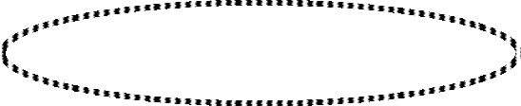


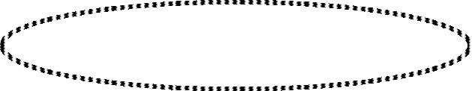
Multiprocessors
26
Cache Coherence
CACHE COHERENCE
X = 52 Main memory
Caches are Coherent
Bus
X = 52
X = 52
X = 52
Caches
P1
P2
P3
Processors
Cache Incoherency in Write Through Policy
X = 120
Main memory
Bus
X = 120
X = 52
X = 52
Caches
P1
P2
P3
Processors
Cache Incoherency in Write Back Policy
X = 52
Main memory
Bus
X = 120
X = 52
X = 52
Caches
P1
P2
P3
Processors

Slide 97
Multiprocessors
27
Cache Coherence
MAINTAINING CACHE COHERENCY
Shared Cache
Disallow private cache
Access time delay
Software Approaches
Read-Only Data are Cacheable
  Private Cache is for Read-Only data
  Shared Writable Data are not cacheable
  Compiler tags data as cacheable and noncacheable
  Degrade performance due to software overhead
Centralized Global Table
  Status of each memory block is maintained in CGT: RO(Read-Only); RW(Read and Write)
  All caches can have copies of RO blocks
  Only one cache can have a copy of RW block
Hardware Approaches
Snoopy Cache Controller
  Cache Controllers monitor all the bus requests from CPUs and IOPs
  All caches attached to the bus monitor the write operations
  When a word in a cache is written, memory is also updated (write through)
  Local snoopy controllers in all other caches check their memory to determine if they have
a copy of that word; If they have, that location is marked invalid(future reference to this location causes cache miss)

